Slide 1

OGC API - Maps
The 126th OGC Member Meeting
Hosted by
Joan Masó (UAB-CREAF)
7 June 2023

Slide 2
Maps (and Tiles) applied to any resource
Tiles TMXS
Tileset
partition
partition
Tileset
Resource
Map resource (style)
subset
Maps BBox
GeoData-resource
(a collection)
Dataset-resource
(the root)
Other (e.g. process result)

Slide 3


Standard documents
OGC API Maps Part2…
OGC API Tiles
Part 2…
OGC API Commons Part2…
OGC API Maps Part 1
OGC API Tiles
Part 1
OGC 20-057
OGC API Commons Part 1
OGC 19-072
Ready to OAB+RFC
Two Dimensional Tile Matrix Set
OGC 17-083r2
Common Tile Matrix Set
In the Definition Servers
Core tiling conceptual and logical model
OGC 19-014r1

Slide 4
Building blocks
Dataset
Dataset
Map
Item
Dataset
Style
Map
Style
Coverage
Dataset
Collection
Style
Map
Tile
Collection
Tile
Dataset
Collection
Item
Style
Map
Map

Slide 5
Building blocks
Dataset
Map
\Map
Dataset
Style
Map
\Styles\Dark\Map
Dataset
Collection
Style
Map
Tile
\Collections\Buildings\Styles\Dark\Map\Tiles\WebMercatorQuad\15\24\10
Dataset
Collection
Item
Style
Map
\Collections\Buildings\Items\EmpireState\Styles\Dark\Map

Slide 6
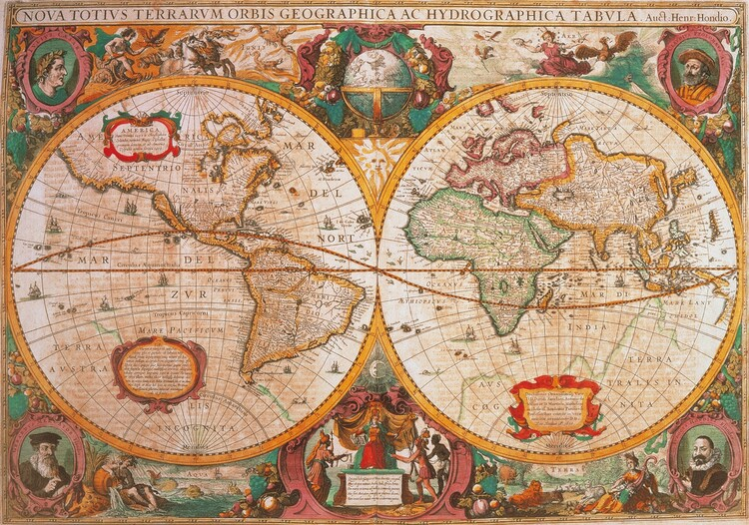
OGC API Maps

Slide 7
History
April – December 2019: Testbed 15 Maps and Tiles API ER (Joan Masó, 19-069) Since Maps and Tiles ER: simplified core requirements class (.../map, no parameter)
June 20 – 21, 2019: OGC API Hackathon in London
July 28 – 29, 2020: OGC API – Maps Code Sprint (ER)
June 2020 – March 2021: Modular OGC API Workflows GeoConnections project
February 17 – 19, 2021: Joint OGC, OSGeo, ASF Code Sprint (ER)
May 26 – 28, 2021: OGC API – Maps, Tiles and Styles Code Sprint (blog post)
March 8 – 10, 2022: Joint OGC, OSGeo, ASF Code Sprint
November 29 – December 1, 2022: Web Mapping Code Sprint in Brussels
February 24, 2023: Editing session in Rome in 125th OGC meeting in Frascati
June 11, 2023: OAB requested some changes in the non-normative text but will be ready soon

Slide 8
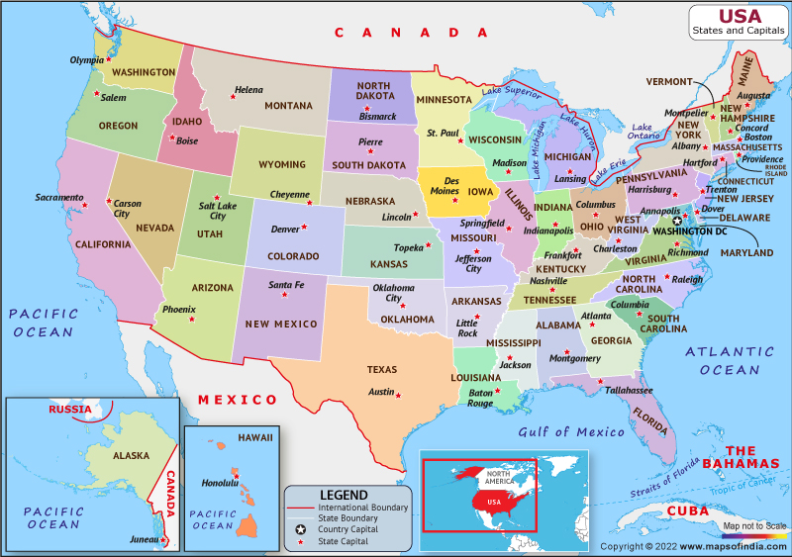
What is a map?
Portrayal of geographic information as a digital representation suitable for display on a rendering device (adapted from OGC 06-042).
It requires to combine data with a style (that defines the symbology of the features)
While it represents the data as a whole, it is usually retrieved as a subset (bbox) of the original data and re-scaled (scale-denominator).

Slide 9
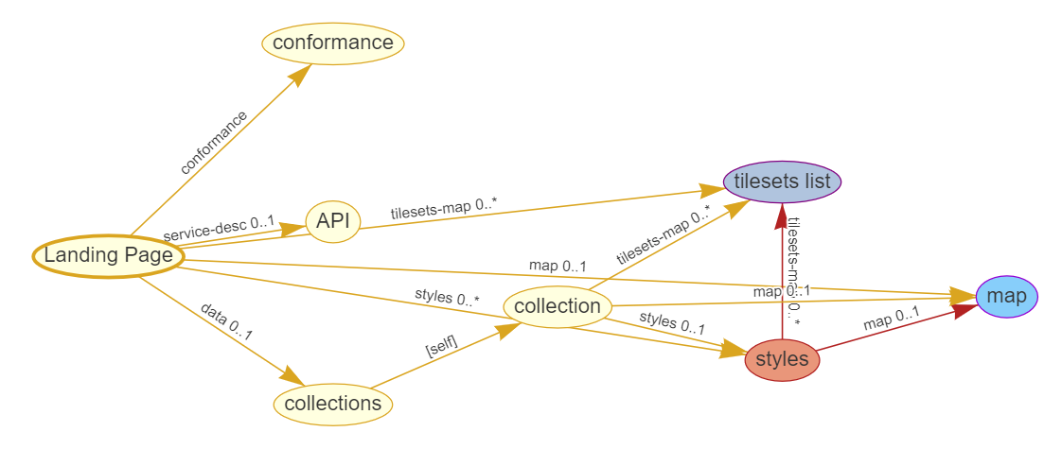
How to get it?
In the OGC APIs a geospatial resource path can be “continued” with the word “map” (proceeded by the style/{styleId} unless a default style is applied)
What resources can be retrieved as maps?
Any resource that has a “link relation” “ogc:map”

Slide 10
Map tiles
Maps can also be retreived as tiles.
We call them “map tiles”
(other tiles such as: “coverage based tiles” or “feature based tiles” contain data instead of portrayals)
In the OGC APIs a geospatial resource path can be “continued” with “map/tiles” (proceeded by the style/{styleId} unless a default style is applied)
What resources can be retrieved as map tiles?
Any resource that has a “link relation” “ogc:tilesets-map”
The same resource ca be retrieved as “maps” and “map tiles” if both “link relations” are listed
And the relevant conformance classes are listed.

Slide 11
Conformance classes to implement
http://www.opengis.net/spec/ogcapi-maps-1/1.0/req/core
http://www.opengis.net/spec/ogcapi-maps-1/1.0/req/tilesets
http://www.opengis.net/spec/ogcapi-maps-1/1.0/req/background
http://www.opengis.net/spec/ogcapi-maps-1/1.0/req/collections-selection
http://www.opengis.net/spec/ogcapi-maps-1/1.0/req/display-resolution
http://www.opengis.net/spec/ogcapi-maps-1/1.0/req/datetime
http://www.opengis.net/spec/ogcapi-maps-1/1.0/req/general-subsetting
http://www.opengis.net/spec/ogcapi-maps-1/1.0/req/crs
http://www.opengis.net/spec/ogcapi-maps-1/1.0/req/orientation
http://www.opengis.net/spec/ogcapi-maps-1/1.0/req/projection
http://www.opengis.net/spec/ogcapi-maps-1/1.0/req/collection-map
http://www.opengis.net/spec/ogcapi-maps-1/1.0/req/dataset-map
http://www.opengis.net/spec/ogcapi-maps-1/1.0/req/styled-map
http://www.opengis.net/spec/ogcapi-maps-1/1.0/req/png
http://www.opengis.net/spec/ogcapi-maps-1/1.0/req/jpeg
http://www.opengis.net/spec/ogcapi-maps-1/1.0/req/tiff
http://www.opengis.net/spec/ogcapi-maps-1/1.0/req/svg
http://www.opengis.net/spec/ogcapi-maps-1/1.0/req/html
http://www.opengis.net/spec/ogcapi-maps-1/1.0/req/oas30

Slide 12
Questions
What is in the map
What resources it represents
What styles are applied
Path parameters (mainly)
How the map is subset
Three ways to specify the area of interest
Or use map tiles
How to define the map size other details
Query parameters

Slide 13
What is in the map
Resources
Core
Retrieve a Map (.../map)
Map Tilesets
Retrieve map tiles (.../map/tiles)
Origins
Collection Maps
Retrieve map from a collection (/collections/{collectionId}/map)
Dataset Maps
Retrieve map form a dataset (/map)
Collections Map
Retrieve map form a dataset (/map?collections={collectionId},{collectionId},…
Styled Maps
Retrieve map from a style (/styles/{styleId}/map)

Slide 14
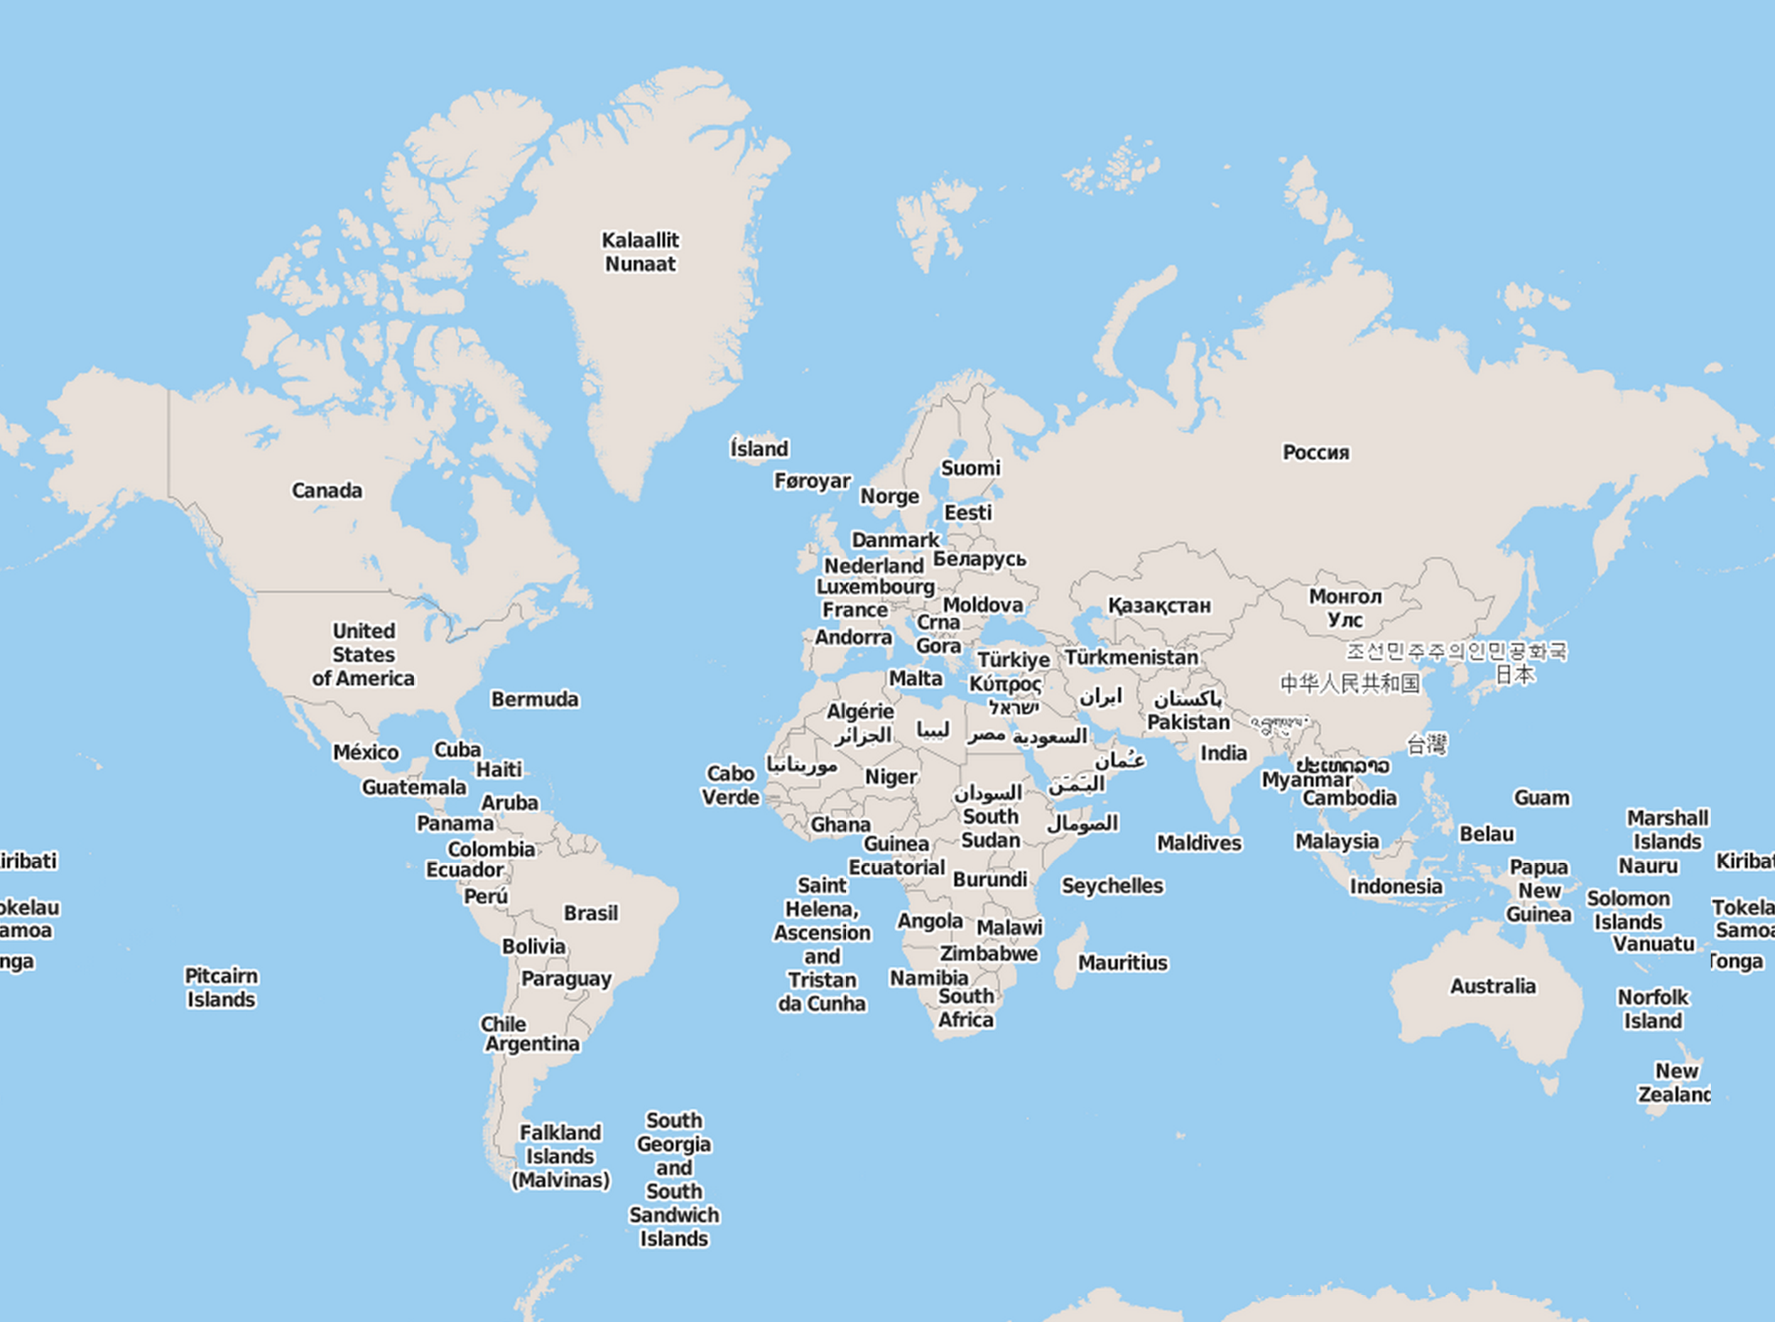
Minimalist Core (Maps)
Retrieve a map from a resource
Server is free to
Return the whole extend or not
Return a reasonable amount of cells
Return a reasonable CRS
Default style
Server will indicate in the response headers the CRS and BBOX

Slide 15
Some Query Parameters
Background (transparent=, bgcolor=)
Control transparency or background color
Scaling (width=, height=, scale-denominator=)
Specify width, height or scale denominator
Display Resolution (mm-per-pixel=)
Override default 0.28mm/pixel (for computing scale)

Slide 16

Query Parameters (subsetting)
Spatial Subsetting (subset=Lat(...),Lon(...); bbox=; center=, scale-denominator=; and the corresponding *-crs)
Retrieve spatial subset of a map
Date & Time (datetime=, subset=time(...))
Retrieve a temporal subset of a map
General Subsetting (e.g., subset=pressure(...))
Retrieve subset of a map in other dimensions
bbox[2]
Lon [2]
bbox[3]
Lat[1]
center[0],center[1]
bbox[1]
Lat0]
bbox[0]
Lon[0]
bbox[0]=centre[0]-(width/2)*scale-denominator*mm-per-pixel/1000
bbox[1]=centre[1]-(height/2)*scale-denominator*mm-per-pixel/1000
bbox[2]=centre[0]-(width/2)*scale-denominator*mm-per-pixel/1000
bbox[3]=centre[1]-(height/2)*scale-denominator*mm-per-pixel/1000
(assuming a bbox-crs in meters)

Slide 17
Requirements classes defining subsets
Requirement Class "Scaling"
Path e.g. /maps?width={width}&height={height}
Requirement Class "Spatial subsetting"
Path e.g. /maps?bbox={bbox}&bbox-crs={crs}
Path e.g. /maps?subset=lon(left_long, right_long),lat(lower_lat,upper_lat)
&subset-crs={crs}
Requirement Class “Centre”
maps?center={}&center-crs={crs},scale-denominator={},mm-per-pixel={},
Requirement Class "DateTime"
How to provide tiles in a domain that has a generic time dimension.
/maps?subset=time(,)

Slide 18
Query Parameters (continued)
Coordinate Reference System (crs=)
Output CRS by reference
Rotation (orientation=)
Rotate map around output center
Custom Projection CRS (crs-proj-method=, crs-proj-params=, crs-proj-center=, crs-datum=)
Support for custom projections listed at /projectionsAndDatums

Slide 19
Formats
Map Formats
PNG
JPEG
(Geo)TIFF
SVG (styled vectors)
HTML (interactive)
(additional formats always allowed)
OpenAPI 3.0 Definition
Defines operationID suffixes to recognize map and map tiles resources

Slide 20
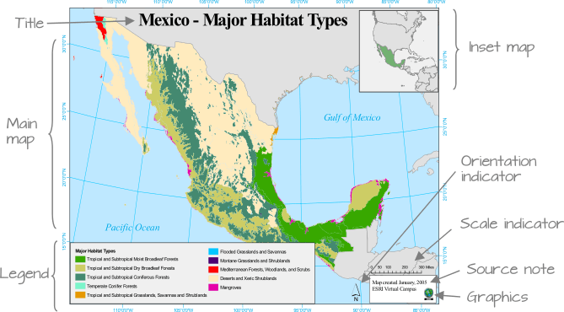
Planned Extensions
Cartographic Layout
Legend, Scale, Compass,…
Attribution, Title, Grid, Situation...
Map Queries
"GetFeatureInfo" for point, Queryables, filter=
Maps of custom styles supplied by clients
Possibly private "temporary" styles with OGC API – Styles
Possibly well-known Process and OGC API – Processes – Part 3

Slide 21
Compare WMS with OGC API Maps
WMS
GetCapabilities
DataURL
GetMap (KVP)
More than one Layer
Style names or SLD
GetFeatureInfo
Multidimensions
OGC API Maps core
Every Collection description and API def
Connected to collections (API Features or API Coverages)
REST interface only
Any combination of collections or the whole dataset
OGC API styles
Resolved using OGC API Features, Coverages, EDR or in an extension
Time is native. Other can be supported by OpenAPI implementation

Slide 22
From a GetMap query to a subset of a map resource
GetMap
https://tiles.maps.eox.at/wms?SERVICE=WMS&VERSION=1.3&REQUEST=GetMap&CRS=EPSG:4326&BBOX=35.1,9.3,45.7,34.3&WIDTH=1500&HEIGHT=635&LAYERS=s2cloudless­2020&FORMAT=image/png&TRANSPARENT=TRUE&STYLES=style
OGC API maps
https://server.bob/api/collections/s2cloudless­2020/styles/style/map?bbox­crs=http://www.opengis.net/def/crs/EPSG/0/4326&bbox=35.1,9.3,45.7,34.3&width=1500&height=635&transparent=true
Accept: image/png (or f= parameter)

Slide 23
Status (today)
We have a regular meeting date-of-the-week + time (Tuesday at 11:00EST) that we are following irregularly.
All the issues in GitHub has been processed and solutions was been agreed and documented in GitHub.
Corrections for Carl are pending to apply
Discussion the clarity of the standard and what goes first and what next
E.g. Explain the differences with WMS in an annex.
So expect a RFC in a month? (previous approval from the OAB).

Slide 24

Thank You
Community

